Slide 1
GITHUB CODEREVIEW TOOL
DUY TAN UNIVERSITY
QNLT Team Members
Lê Hoàng Quốc
Nguyễn Xuân Thủy
Thiện Nhân
Nguyễn Thị Khánh Ly

Slide 2


1. WHAT IS GITHUP ?
GitHub is a code hosting platform for version control and collaboration. It lets you and others work together on projects from anywhere.

Slide 3
2. FEATURE
1. Integrated issue tracking.
2. Collaborative code review.
3. Easily manage teams within organizations.

Slide 4
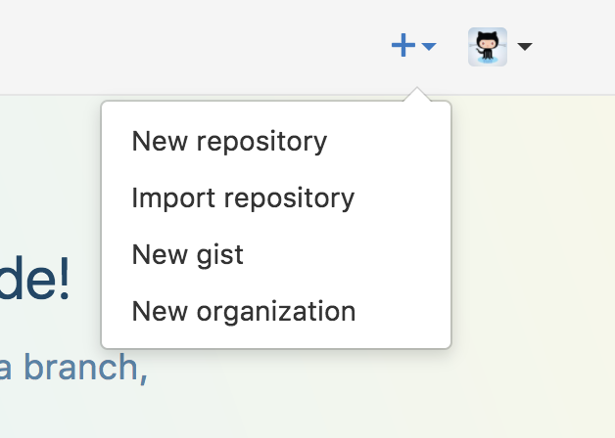
3. DEMO
Create Your Website
Once you’ve signed in, you’ll create a new repository to get started.

Slide 5
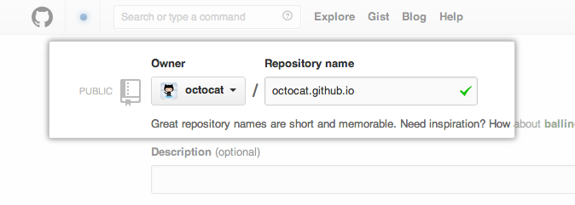
3. DEMO
On the new repository screen, you need to give this repository a special name to generate your website.

Slide 6
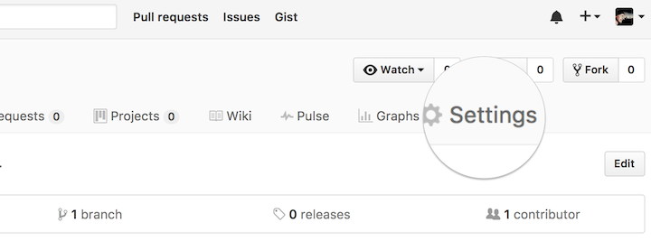
3. DEMO
Your website’s files will live in a repository named username.github.io(where “username” is your actual GitHub user name). To begin setting up your site, you have to open the Settings tab

Slide 7
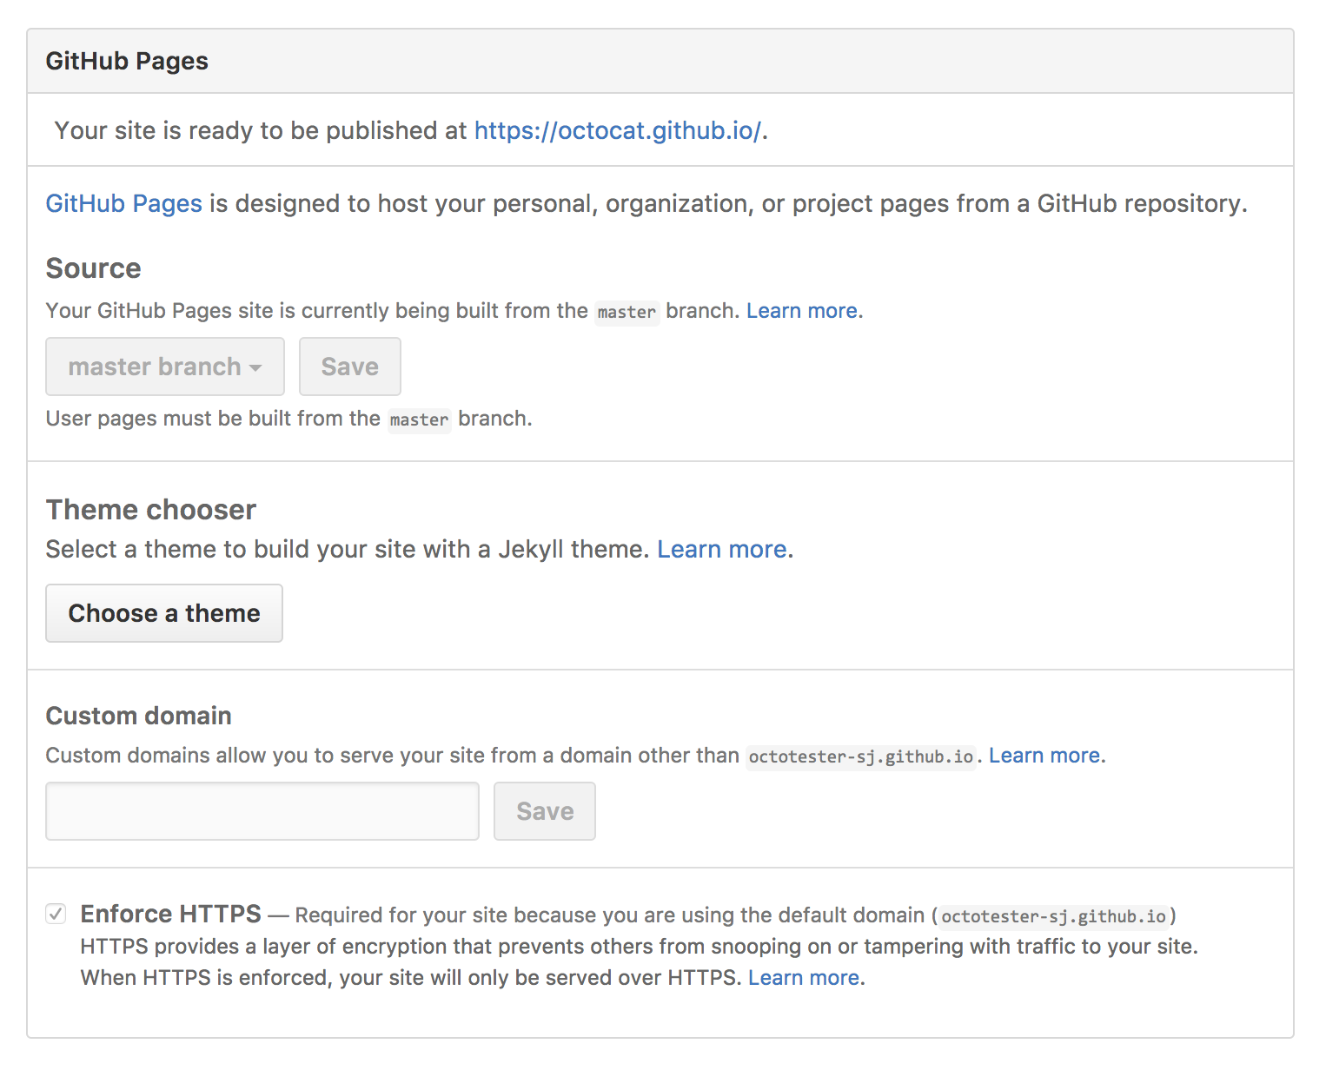
3. DEMO
If you scroll down on the settings page, you’ll see the GitHub Pages section near the bottom. Click the Choose a theme button to start the process of creating your site.

Slide 8
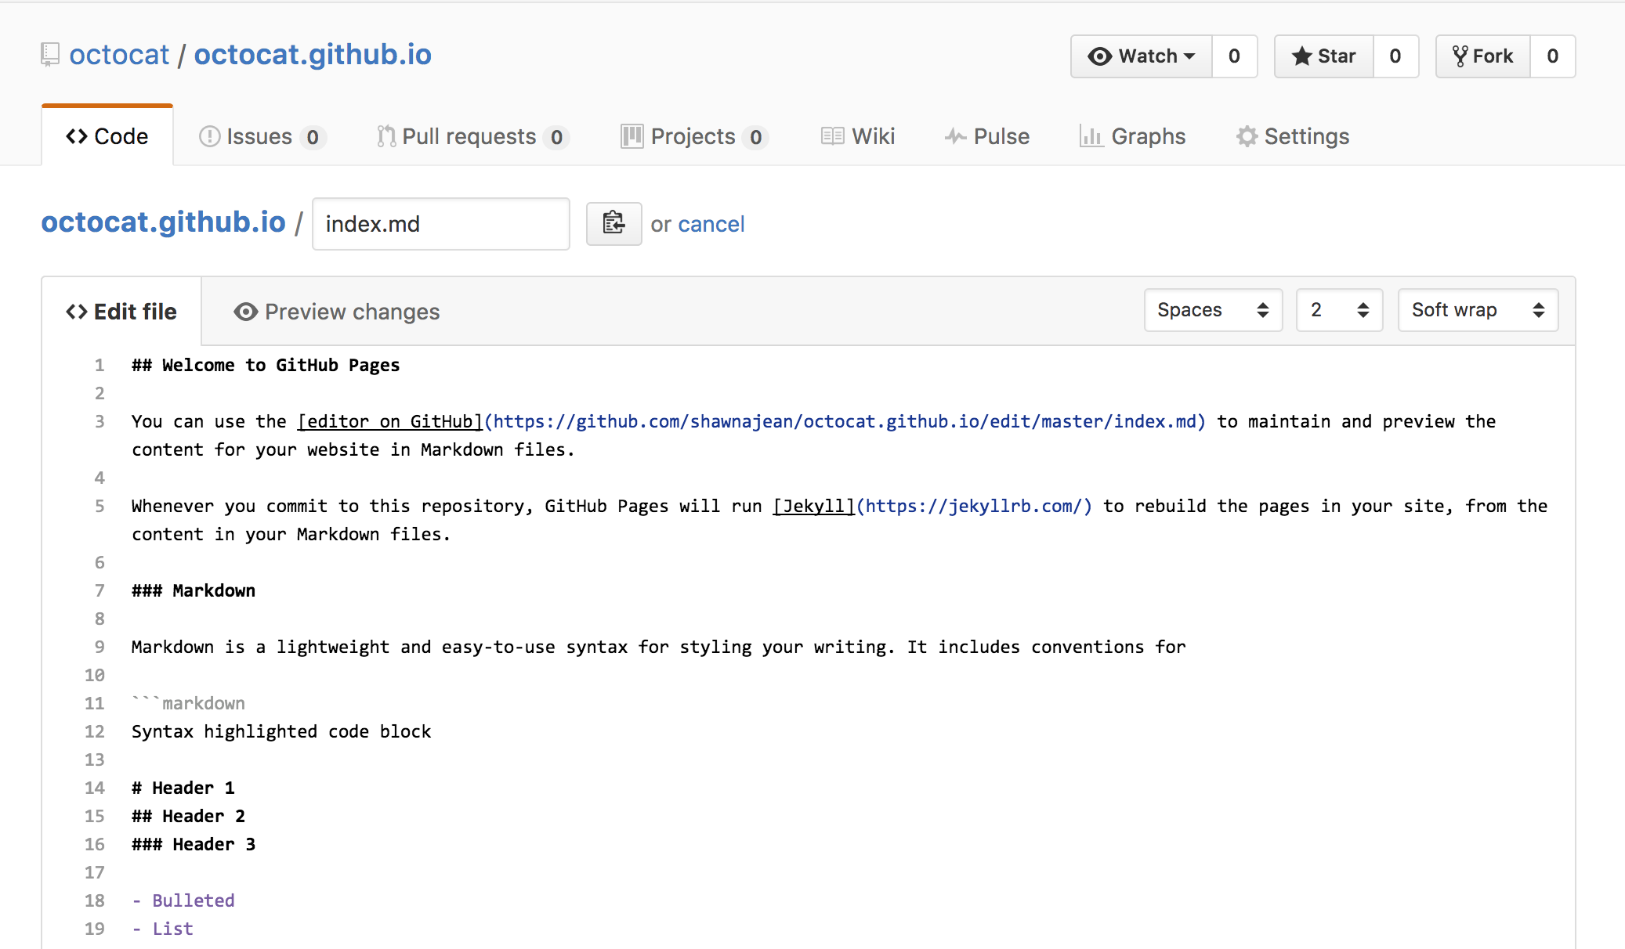
3. DEMO
If you scroll down on the settings page, you’ll see the GitHub Pages section near the bottom. Click the Choose a theme button to start the process of creating your site.

Slide 9
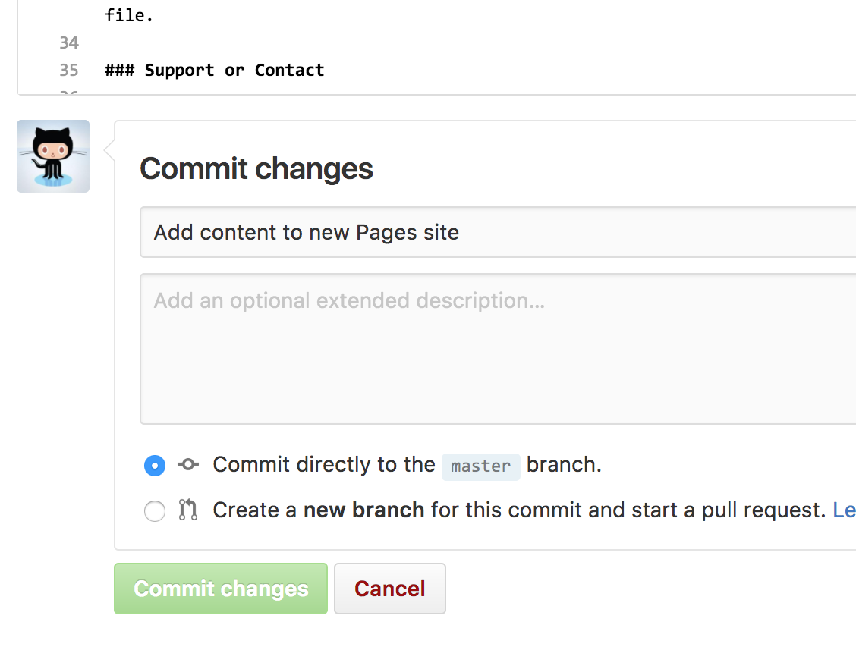
3. DEMO
Once you’re finished editing, scroll down to the bottom of the page and click Commit changes.

Slide 10
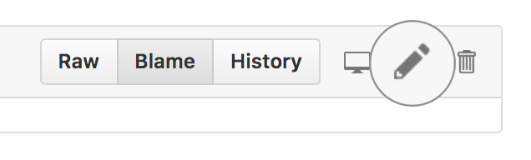
3. DEMO
Making Changes

Slide 11
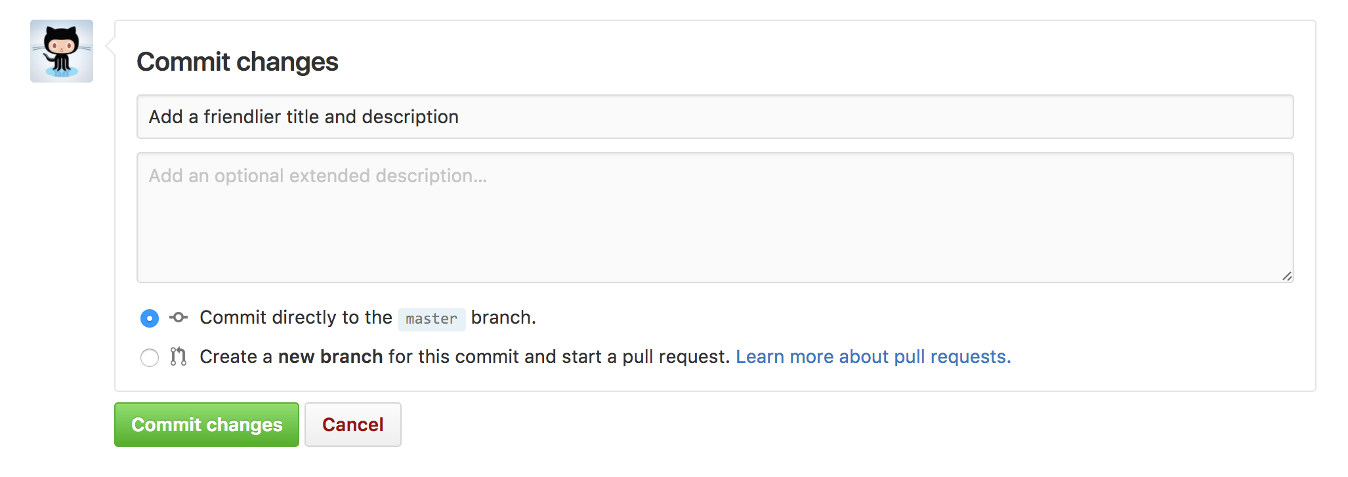
3. DEMO
When you’re done, click Commit changes and your updates will go live in just a few seconds!

